Slide 1
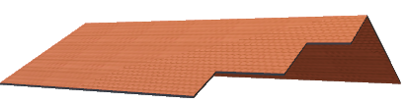
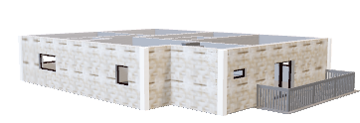
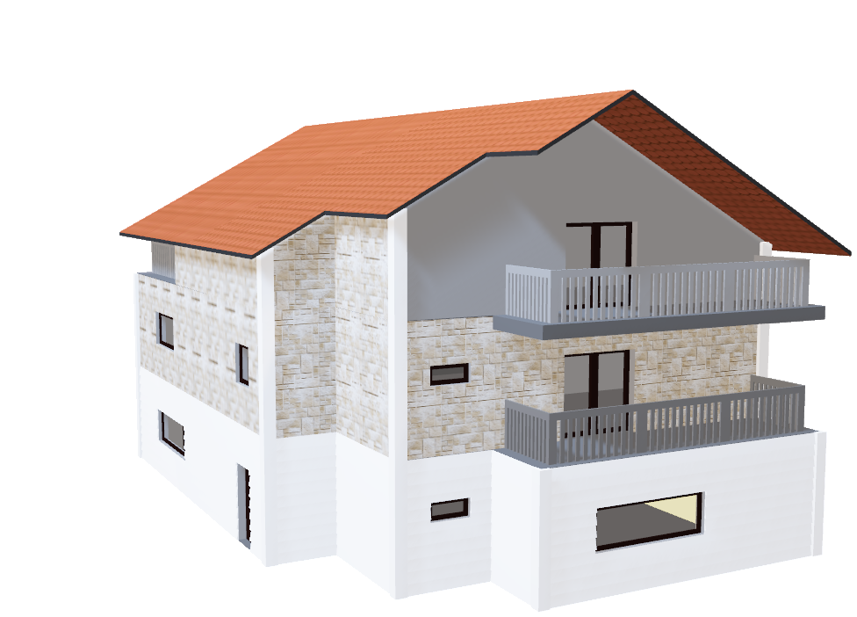
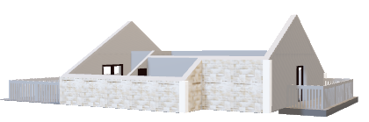
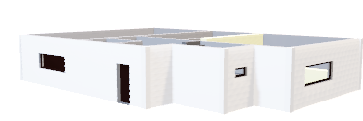
SMART HOME SYSTEM
BY : Yasmeen Yasser Mohamed
Supervised by : Eng. Mahmoud Samir
Eng. Shehab Ahmed

Slide 2
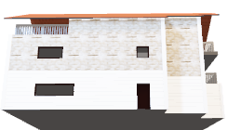
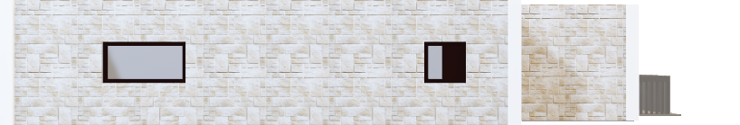
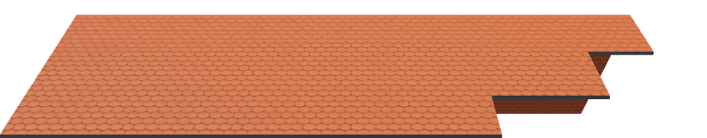
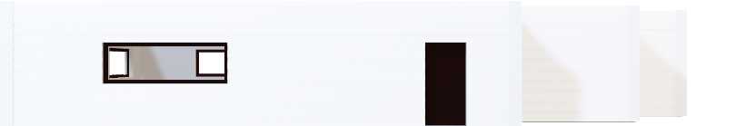
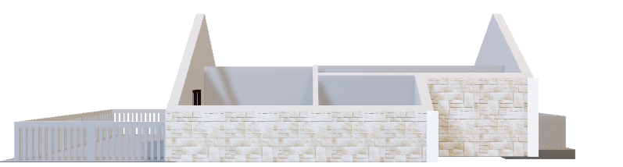
FRONT: 1-home door. 2-garage door. 3-LDR to detect the time (morning, evening, in between). 4-bell. 5-3 ststes leds .
HOME CONTINTES
4 Rooms:
We represent it as Leds
TV:
We represent it as led
Air conditioner:
We represent it as motor
It has two modes:
1-the system control it by comparing the temperature with the temperature read by the temperature sensor
2-the user could control it by switch

Slide 3
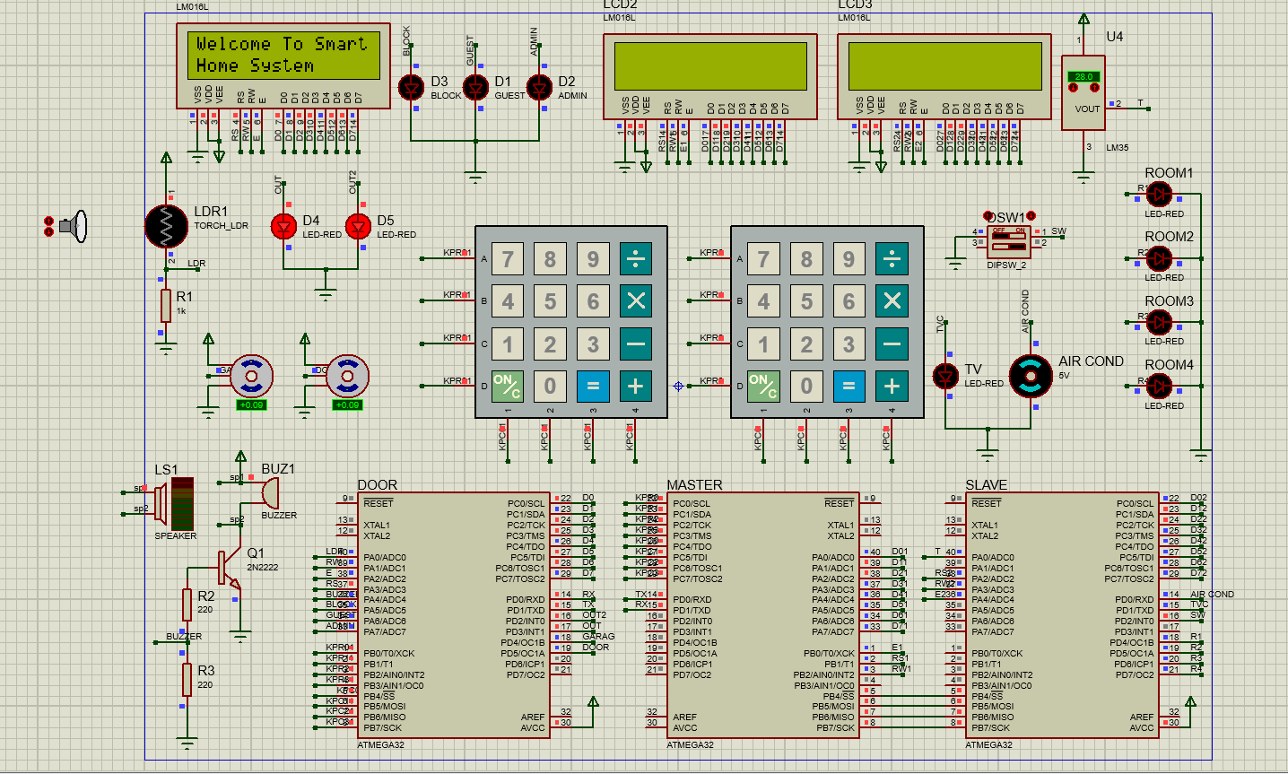
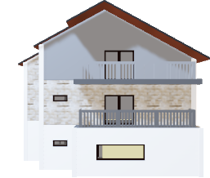
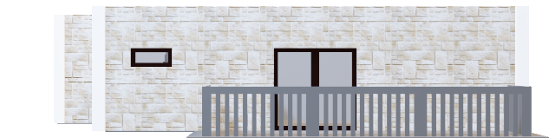
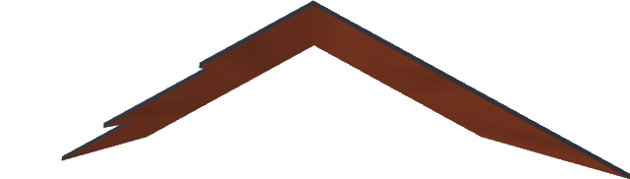
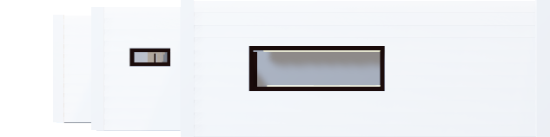
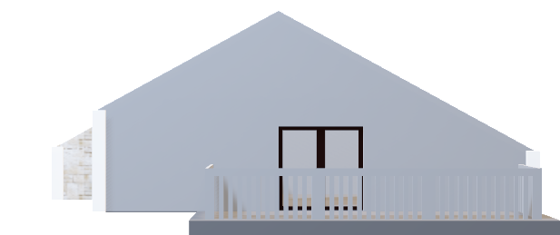
OUR HOME IN PROTEUS
ROOF:
Stepped rear design offers attractive viewing profile
3rd FLOOR:
Large terrace finished in cool grey for the perfect neutral effect
2nd FLOOR:
Stone tiling is delightfully accompanied by soft grey tones
1st FLOOR:
Panoramic window allows natural light to flow into the house

Slide 4
Drivers Used:
Door MCU:
-BIT_MATH LIB
-STD_TYPES_LIB
-Smart Home-CONFIG LIB -DIO DRIVER
-ADC DRIVER
-LCD DRIVER
-KPD DRIVER
-TIMER1 DRIVER
-UART DRIVER
MASTER MCU:
-BIT_MATH LIB
-STD_TYPES_LIB -DIO DRIVER
-LCD DRIVER
-KPD DRIVER
-SPI DRIVER
-UART DRIVER
SLAVE MCU:
-BIT_MATH LIB
-STD_TYPES_LIB
-Smart Home-CONFIG LIB -DIO DRIVER
-ADC DRIVER
-EXT_INT0 DRIVER
-LCD DRIVER
-SPI DRIVER

Slide 5
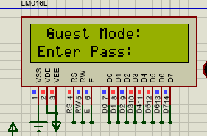
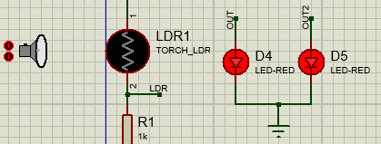
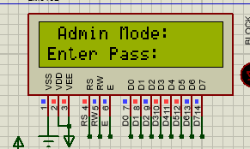
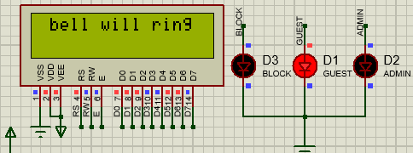
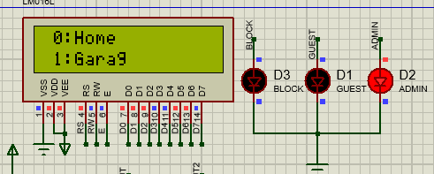
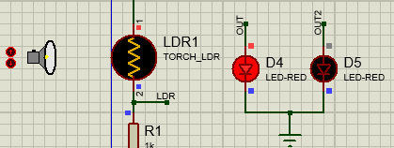
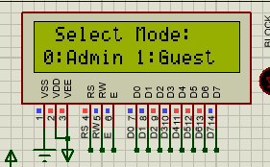
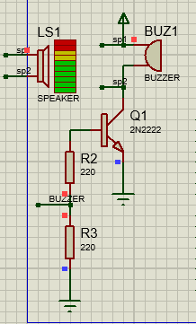
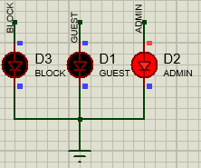
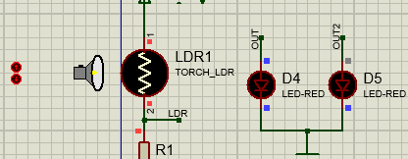
FIREST MICROCONTROLLER FUNCTIONS: (Door MCU)
Evening(it is dark)
In between (there is little light)
Morning(it is light)
1-SELECT MODE
2-GUEST MODE
3-ADMIN MODE
3-LDR

Slide 6
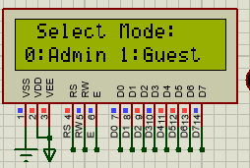
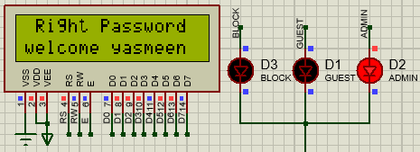
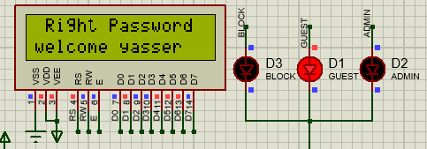
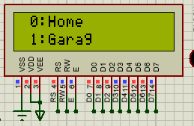
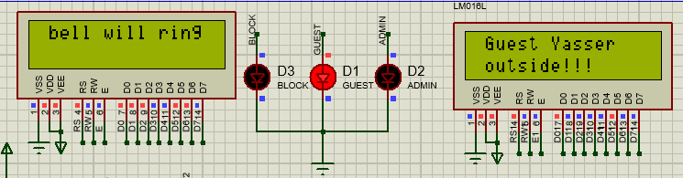
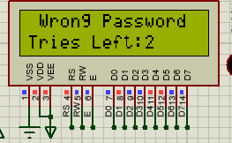
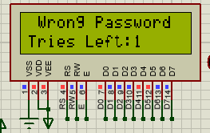
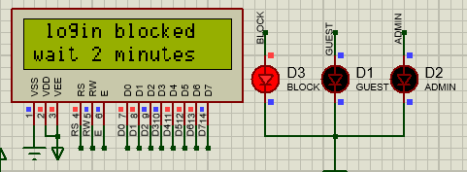
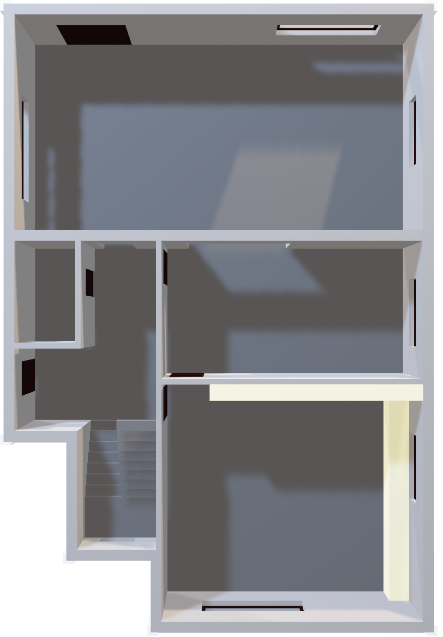
Door Functions
If he log in correctly as admin:
1- admin led will turn on.
2-he will choose if he want to enter the home or rhe garage.
1-Log in system:
-after choosing admin mode or guest mode the user must enter correct password , the system will give the user number of tries it is configurable could change very easy .
-if user take all of his
tries he will enter the block mode (for 2 minutes), then he will try again.
Ex: if he have 3 tries:
If he log in correctly as Guest:
1-guest led will turn on
2-the bell will ring for 1 minute.
3- the master microcontroller will say that there is a gust here.
4-bell and guest led will turn off .
3rd Floor

Slide 7
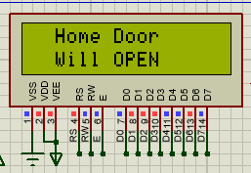
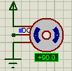
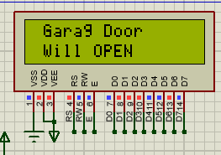
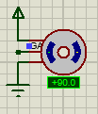
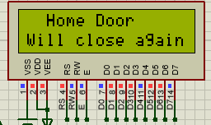
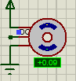
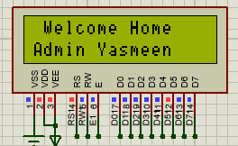
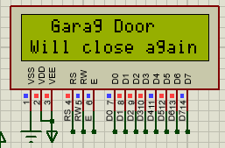
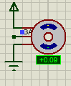
Admin mode cont.
If he choose home:
The home door will open for 1 minute to let him get in .
after the door close
the door
Microcontroller till
the master that
there is admin get
in to make him start it ‘s functions.
If he choose Garag:
The garage door will open for 1 minute
Then close again and admin led will turn off.

Slide 8
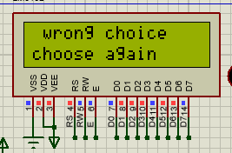
NOTE THAT:
If the user enter any wrong choice the system will detect that and make him choose again.
This happen every ware throw the system.

Slide 9
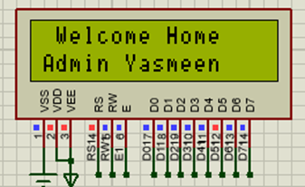
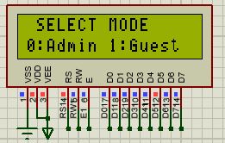
AFTER the admin enter the home the Master microcontroller will start working:
If the user press enter’=‘ the system will change the welcome page and move to the options

Slide 10
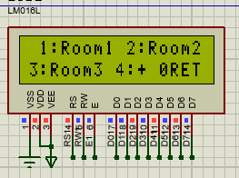
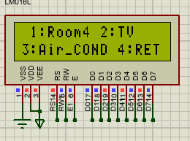
Admin mode:
The admin could control that:
-Room1
-Room2
-Room3
-Room4
-TV
-AIR condationer

Slide 11
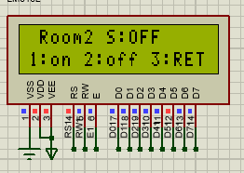



Admin mode:
Room2
Room3
Room1
Room4

Slide 12


Admin mode:
TV
Air Conditioner

Slide 13

Guest mode:
The guest could control that:
-Room1
-Room2
-Room3
-Room4

Slide 14
Guest mode:
Room2
Room3
Room1
Room4

Slide 15

Anytime if the user feel that he didn’t need to use the system anymore he could return to moodes page and press enter ’=‘ so in this time the system will stop taking orders and waiting for new action come to him from the door MCU

Slide 16
Now the Slave MCU WILL START FUNCTION
When the Master MCU Take the order he will send it to the slave MCU TO Execute him:
1-it will light the Rooms on and off.
2-it will turn tv on or off.
3-it will read the temperature sensor and decide if it will turn the air conditioner on or not .
4- any time the switch pressed it will turn air conditioner on no matter the room temperature.
5-it will display any action on the screen.

Slide 17
THANK YOU.

